Slide 1
Mr. D. V. Bondar
Dept. Of Chemistry
S.C.S.College, Omerga.

Slide 2
Theory of Volumetric analysis

Slide 3
syllabus
Types of titrations, volumetric apparatus, calibration of pipette and burette.
Indicators used in pH - titrations, oxidizing agents used in titrations.
Theory of Internal, External and self indicators for redox titration

Slide 4
Volumetric analysis (titrimetric analysis):
The term Volumetric analysis refers to quantitative chemical analysis carried out by determining the volume of a solution of accurately known concentration which is required to react with a measured volume of a solution of a substance to be determined. The solution of known concentration is called standard solution.

Slide 5
For use in Volumetric analysis a reaction must have the following conditions:
There must be a simple reaction which can be expressed by a chemical equation and the substance to be determined should react completely with the reagent in equivalent proportion.
The reaction should be fast .
There must be an alteration in some physical or chemical properties of the solution at equivalent point.
An indicator should be available which should define the end point of the reaction.

Slide 6
Standard solution:
A standard is a solution of precisely known concentration
It must be available in a highly pure state
It must be stable in air
It must dissolve easily in water
It should have a fairly high relative molecular weight
It should under go a complete and rapid reaction

Slide 7
Definition of terms:
Titration
A process in which a standard reagent is added to a solution of analyte until the reaction between the two is complete.
Primary Standard A reagent solution of accurately known concentration is called a standard solution.
Standardization
A process to determine the concentration of a solution of known concentration by titrating with a primary standard

Slide 8
End point:
The point at which the reaction is observed to be completed is the end point
The end point in volumetric method of analysis is the signal that tells the analyst to stop adding reagent and make the final reading on the burette.
Endpoint is observed with the help of indicator
Equivalent point:
The point at which an equivalent or stoichiometric amount of titrant is added to the analyte based on the stoichiometric equation
Indicators:
Are often added to analyte solution in order to give an observable physical change at or near the end point.

Slide 9
Equipment:
Burette
Volumetric flask(Conical flask)
Pipette
Funnel
Indicator
White tile

Slide 10
Procedure:
Two solutions are used:
The solution of unknown concentration;
The solution of known concentration – this is also known as the standard solution
Write a balanced equation for the reaction between your two chemicals
Clean all glassware to be used with distilled water. The pipettes and burettes will be rinsed with the solutions you are adding to them

Slide 11
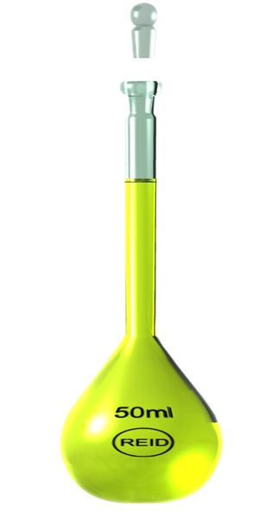
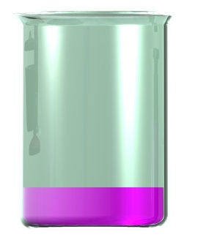
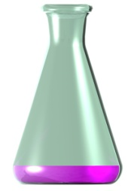
Process – The Setup
The burette is attached to a clamp stand above a conical flask
The burette is filled with one of the solutions (in this case a yellow standard solution)
A pipette is used to measure an aliquot of the other solution (in this case a purple solution of unknown concentration) into the conical flask
Prepare a number of flasks for repeat tests
Last, an indicator is added to the conical flask

Slide 12
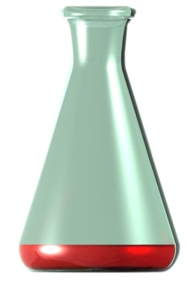
Process – The Titration
Read the initial level of liquid in the burette
Turn the tap to start pouring out liquid of the burette into the flask. Swirl the flask continuously. When the indicator begins to change colour slow the flow.
When the colour changes permanently, stop the flow and read the final volume. The volume change needs to be calculated (and written down). This volume is called a titre
Repeat the titration with a new flask now that you know the ‘rough’ volume required. Repeat until you get precise results

Slide 13
Calculations:
Mean titer:
The first thing we do is to calculate the mean (average) titre:
titer = 12.6 ml 13 ml 12.9 ml
Mean = sum of the titers
number of titers
= 12.6 + 13+ 12.9
3
= 12.8 ml

Slide 14
Unknown concentration:
Write down the balanced equation e.g.
HCl + NaOH → NaCl + H₂O
Write down everything else we know. This will be:
Volume of liquid in the pipette.
Mean titre (from burette).
The concentration of the standard solution.

Slide 15
Now as we have V , M for the standard and V for the unknown we can calculate the unknown concentration from the equation below:
_{(standard )}M x V = M’ x V’_{(unknown)}
Ex:
10 ml of NaOH solution is standardized by titrating 0.1 M of HCl. If 9 ml is required for titration;
Write down the chemical equation for the reaction.
Calculate NaOH Molarity.

Slide 16
The equation:
NaOH Molarity:
Given:
M_{HCl} 0.1 M
V_{HCl} 9 ml
V’_{NaOH} 10 ml
M’_{NaOH} ??
So,
_{(HCl)}M x V = M’ x V’_{(NaOH)}
M’ = M x V = 0.1 x 9 = 0.09 M
V’ 10
HCl + NaOH → NaCl + H₂O

Slide 17
Another example:
H₂SO₄ + 2NaOH → Na₂SO₄ + 2H₂O
Titres: 9.0mL, 9.1mL, 9.3mL, 9.0mL
Known (standard) solution details:
H₂SO₄(in the burette), M = 0.1 M
Unknown solution details: NaOH
M’=??
V’= 10mL

Slide 18
calculation:
_{(H2SO4)}M x V = M’ x V’ _{(NaOH)}
From the equation:
2NaOH + H₂SO₄ → Na₂SO₄ + 2H₂O
2 : 1
At equivalent point:
2 moles of NaOH is reacted with 1 mole of H₂SO₄
So;
number of moles of NaOH = 2 , M = n ;
number of moles of H₂SO₄ 1 v
n = M x V
M_{NaOH} × V_{NaOH} = 2
M_{H2SO4} × V_{H2SO4} 1

Slide 19
M_{NaOH} × 10 = 2
0.1 x 9.1 1
M _{NaOH} = 0.1 x 9.1 x 2
10 x1
M _{NaOH} = 0.1 X 9.1 X 2 = 0.182 M
10 x 1

Slide 20
Direct titration:
When a titrant reacts directly with an analyte the procedure is termed as direct titration.
Back titration:
It is a technique used to find the concentration of a reactant of unknown concentration by reacting it with an excess volume of another reactant of known concentration. The resulting mixture is then titrated back, taking into account the concentration of the excess which was added.
Back titrations can be used for many reasons, including: when the sample is not soluble in water, when the sample contains impurities that interfere with forward titration, or when the end-point is more easily identified than in forward titration.

Slide 21
Types of Titrations

Slide 22
1. Acid-Base Titration
The strength of an acid can be determined using a standard solution of a base. This process is called acidimetry. In the same way, the strength of a base can be found with the help of a standard solution of an acid, which is known as alkalimetry. Both titrations involve in the neutralization reaction of an alkali.
What is Acid-Base Titration?
It is a quantitative analysis method to determine an acid’s or bases’ concentration by precisely neutralizing them with a standard solution of either acid or base of known concentration. It is monitored with the help of a pH indicator to know the development of the acid-base reaction.

Slide 23
HA+BOH→BA+H₂O
Acid + Alkali→Salt + Water
Or H⁺ + A– + B⁺ + OH– → B⁺ + A– + H₂O
Or H⁺ + OH– → H₂O
The acid-base titration is based on the reaction that neutralization is between a base or an acidic and analyte. In this type, a reagent is mixed with the sample solution until it reaches the required pH level. This type of titration majorly depends on the track change in pH or a pH meter.

Slide 24
2. Redox Titrations
The redox titration is also known as an oxidation-reduction reaction. In this type of titration, the chemical reaction takes place with a transfer of electrons in the reacting ions of aqueous solutions. The titrations are named after the reagent that is used in are as follows;
Permanganate Titrations
Dichromate Titrations
Iodimetric and Iodometric Titrations

Slide 25
Permanganate Titrations
In this titration, the potassium permanganate is used as an oxidizing agent. It is maintained with the use of dilute sulphuric acid. Here is the equation.
2KMnO₄ + 3H₂SO₄ → K₂SO₄ + 2MnSO₄ + 3H₂O + 5[O]
Or MnO4– + 8H⁺ + 5e– → Mn²⁺+ 4H₂O
Further, the solution remains colourless before the endpoint. The potassium permanganate is used to estimate oxalic acid, ferrous salts, hydrogen peroxide, oxalates and more. While the solution of potassium permanganate is always standardized before it is used.

Slide 26
Dichromate Titrations
These are titrations in which, potassium dichromate is used as an oxidising agent in acidic medium. The medium is maintained acidic by the use of dilute sulphuric acid. The potential equation is:
K₂Cr₂O₇ + 4H₂SO₄ → K₂SO₄ + Cr₂(SO₄)₃ + 4H₂O + 3[O]
Or Cr₂O7²⁻ + 14H⁺ + 6e– → 2 Cr³⁺ + 7H₂O
The solution of potassium dichromate can be directly used for titrations. It is mainly used for the estimation of ferrous salts and iodides.

Slide 27
Iodimetric and Iodometric Titrations
The reduction of free iodine to iodide ions and
oxidation of iodide ions to free iodine occurs in these titrations.
l² + 2e– → 2l–……………. (reduction)
2l– → I₂ + 2e– ……………. (oxidation)
The solution is used as an indicator. Free iodine is used in the iodimetric titration, while in the iodometric titration an oxidation agent is used to react to liberate free iodine.

Slide 28
3. Precipitation Titrations
The titration is based on the insoluble precipitate formation when the two reacting substances are brought into contact are called precipitation titration. For instance, when the solution of silver nitrate is used to a solution of ammonium thiocyanate or sodium chloride, it reacts and forms a white precipitate of silver thiocyanate or silver chloride.
AgNO₃ + NaCl → AgCl + NaNO₃
AgNO₃ + NH₄CNS → AgCNS + NH₄NO₃

Slide 29
4. Complexometric Titrations
The complexometric titration is where an undissociated complex is formed at an equivalence point. It is greater than the precipitation titrations, and there will be no error due to co-precipitations.
Hg²⁺ + 2SCN– → Hg(SCN)₂
Ag⁺ + 2CN– → [Ag(CN)₂]–
Ethylenediaminetetraacetic acid (EDTA) is an important reagent that forms complexes with metals.

Slide 47
Indicators used in PH - titrations

Slide 48
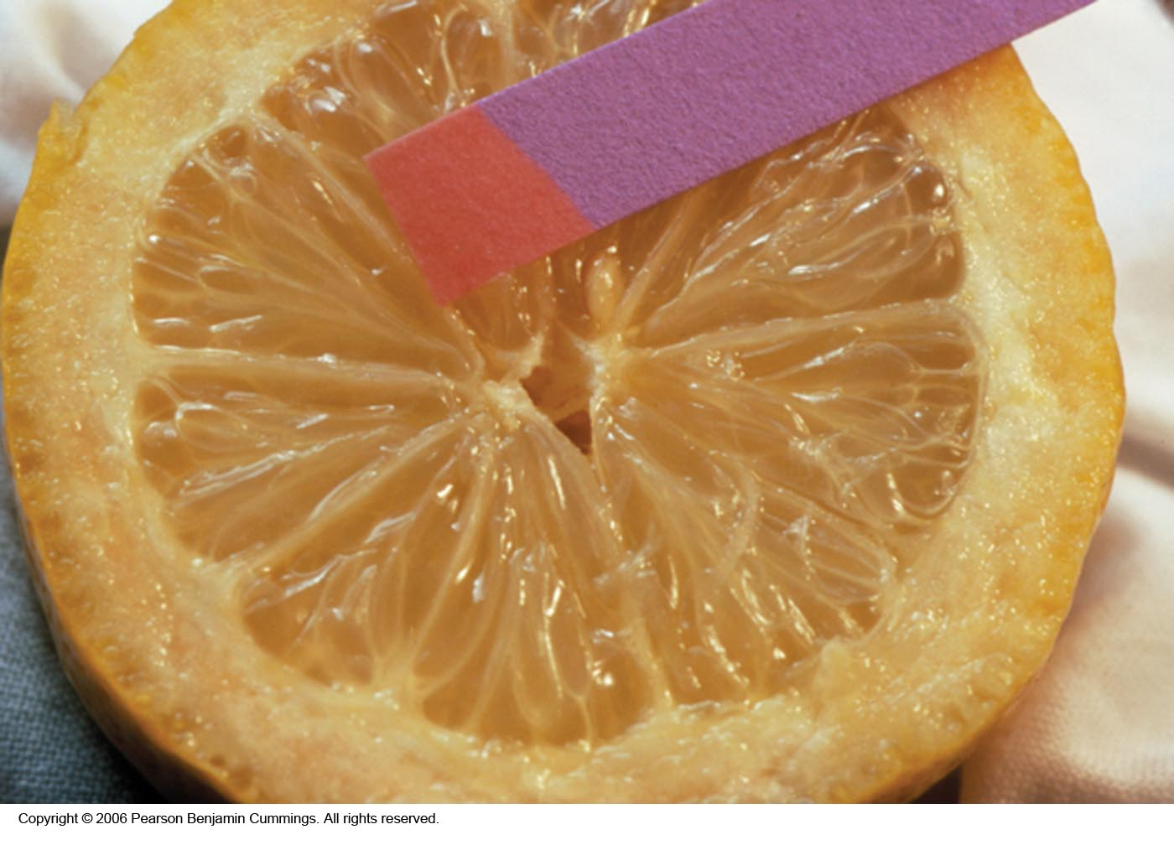
Litmus Paper
Copyright © 2007 Pearson Benjamin Cummings. All rights reserved.

Slide 49
pH Paper
pH 0 1 2 3 4 5 6
pH 7 8 9 10 11 12 13

Slide 50
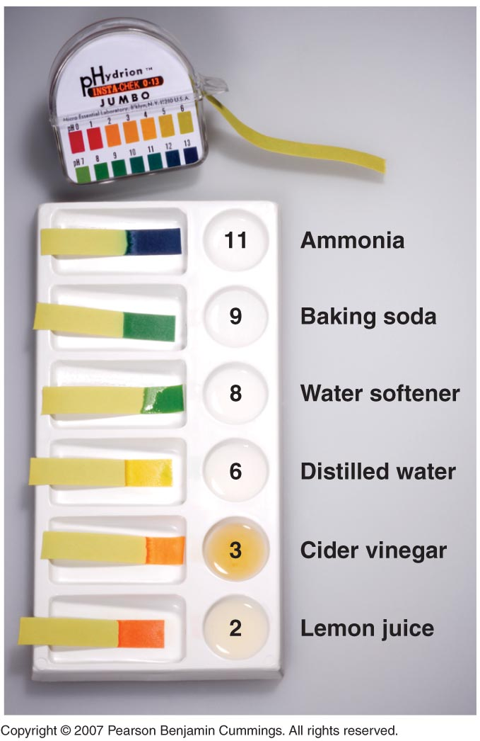
Copyright © 2007 Pearson Benjamin Cummings. All rights reserved.

Slide 51
Paper or plastic strips that contain combinations of indicators estimate the pH of a solution by simply dipping a piece of pH paper into it and comparing the resulting color with standards printed on the container

Slide 52
Desired Features of Sensors
pH paper 1904
pH 0 1 2 3 4 5 6
pH 7 8 9 10 11 12 13
Detection limit
Low deflection
High sensitivity
High selectivity
Wide dynamic range
Simple to use
Cost-effective
Notes:
Most acid-base titrations are not monitored by recording the pH as a function of the amount of the strong acid or base solution used as a titrant
Instead, an acid-base indicator is used, and they are compounds that change color at a particular pH and if carefully selected, undergo a dramatic color change at the pH corresponding to the equivalence point of the titration
Acid-base indicators are typically weak acids or bases whose changes in color correspond to deprotonation or protonation of the indicator itself
The chemistry of indicators are described by the general equation HΙn_{(aq)} ⇋ H⁺ _{(aq)} + Ιn–_{(aq)}, where the protonated form is designated by HΙn and the conjugate base by Ιn–
The ionization constant for the deprotonation of indicator HΙn is K_{in} = [H⁺] [Ιn–] / [HΙn]
The value of pK_{in} determines the pH at which the indicator changes color A good indicator must have the following properties:
1. Color change must be easily detected
2. Color change must be rapid
3. Indicator molecule must not react with the substance being titrated
4. The indicator should have a pK_{in} that is within one pH unit of the expected pH at the equivalence point of the titration
• Synthetic indicators have been developed that meet the above criteria and cover the entire pH range
• An indicator does not change color abruptly at a particular pH but undergoes a pH titration like any other acid or base

Slide 53
Most acid-base titrations are not monitored by recording the pH as a function of the amount of the strong acid or base solution used as a titrant
Instead, an acid-base indicator is used, and they are compounds that change color at a particular pH and if carefully selected, undergo a dramatic color change at the pH corresponding to the equivalence point of the titration
Acid-base indicators are typically weak acids or bases whose changes in color correspond to deprotonation or protonation of the indicator itself
The chemistry of indicators are described by the general equation HΙn_{(aq)} ⇋ H⁺ _{(aq)} + Ιn–_{(aq)}, where the protonated form is designated by HΙn and the conjugate base by Ιn–
The ionization constant for the deprotonation of indicator HΙn is K_{in} = [H⁺] [Ιn–] / [HΙn]
The value of pK_{in} determines the pH at which the indicator changes color A good indicator must have the following properties:
1. Color change must be easily detected
2. Color change must be rapid
3. Indicator molecule must not react with the substance being titrated
4. The indicator should have a pK_{in} that is within one pH unit of the expected pH at the equivalence point of the titration
• Synthetic indicators have been developed that meet the above criteria and cover the entire pH range
• An indicator does not change color abruptly at a particular pH but undergoes a pH titration like any other acid or base

Slide 54
Range and Color Changes of Some
Common Acid-Base Indicators
pH Scale
1
2
3
4
5
6
7
8
9
10
11
12
13
14
Indicators
Methyl orange red 3.1 – 4.4 yellow
Methyl red red 4.4 6.2 yellow
Bromthymol blue yellow 6.2 7.6 blue
Neutral red red 6.8 8.0 yellow
Phenolphthalein colorless 8.0 10.0 red colorless beyond 13.0
Bromthymol blue indicator would be used in titrating a strong acid with a strong base.
Phenolpthalein indicator would be used in titrating a weak acid with a strong base.
would be used in titrating a Methyl orange indicator strong acid with a weak base.

Slide 55
Choosing the correct indicator for an acid-base titration
1. For titrations of strong acids and strong bases (and vice versa), any indicator with a pK_{in} between 4 and 10 will do
2. For the titration of a weak acid, the pH at the equivalence point is greater than 7, and an indicator such as phenolphthalein or thymol blue, with pK_{in} > 7, should be used
3. For the titration of a weak base, where the pH at the equivalence point is less than 7, an indicator such as methyl red or bromcresol blue, with pK_{in} < 7, should be used

Slide 56
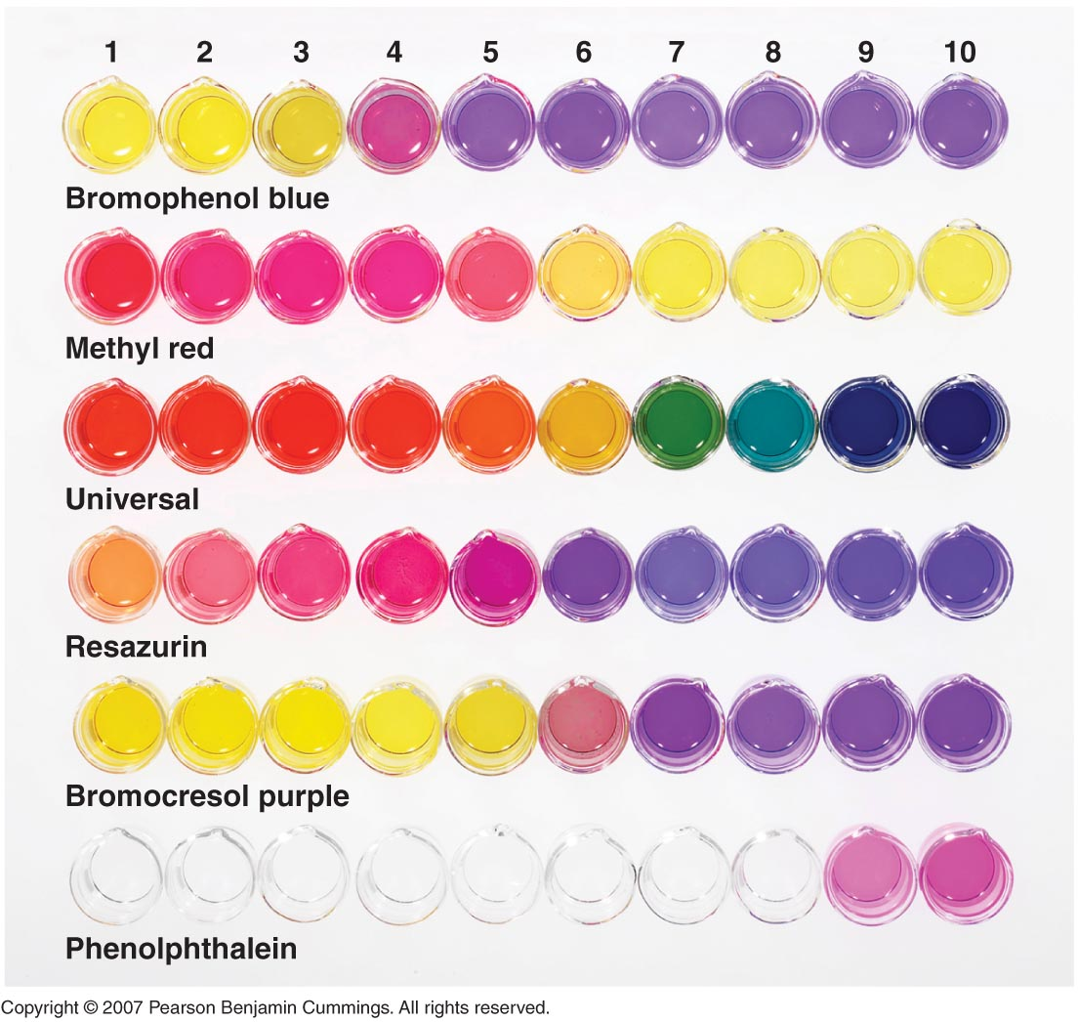
pH
Copyright © 2007 Pearson Benjamin Cummings. All rights reserved.

Slide 57
INDICATOR COLORS IN TITRATION
Indicator
Acid color
Transition color
Base color
STRONG ACID – STRONG BASE
Litmus
2 3 4 5 6 7 8 9 10 11 12
pH
Bromthymol blue

Slide 58
INDICATOR COLORS IN TITRATION
Indicator
Acid color
Transition color
Base color
WEAK ACID – STRONG BASE
Phenolphthalein
2 3 4 5 6 7 8 9 10 11 12
pH
Phenol red

Slide 59
INDICATOR COLORS IN TITRATION
Indicator
Acid color
Transition color
Base color
STRONG ACID – WEAK BASE
Methyl orange
2 3 4 5 6 7 8 9 10 11 12
pH
Bromphenol blue

Slide 60
Indicator
1
2
3
4
5
6
7
8
9
10
11
12
Phenolphthalein
Colorless
Pink
Red
Methyl Red
Red
Orange
Yellow
Orange IV
Orange
Peach
Yellow

Slide 61
Indicator Colors in Titration

Slide 62
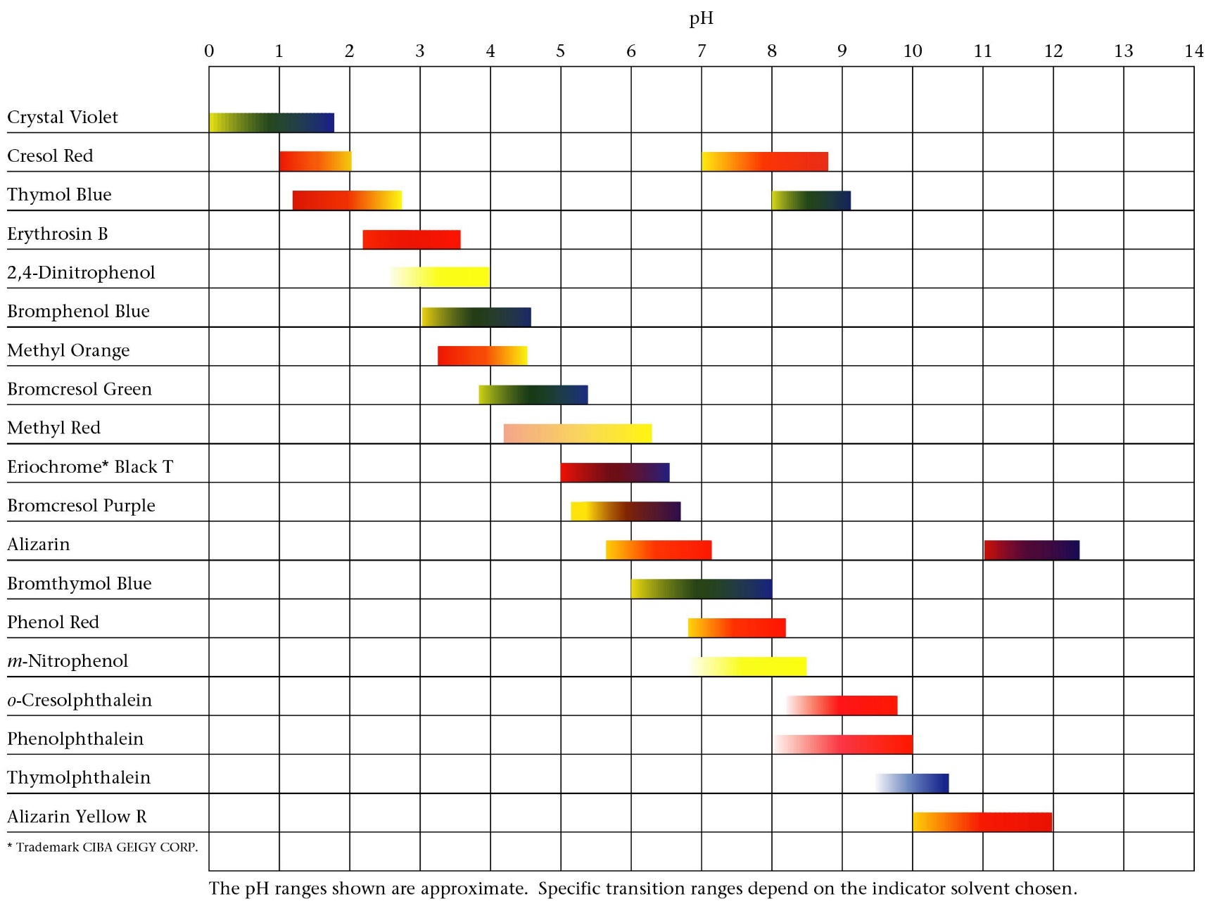
Common pH Indicators
Zumdahl, Zumdahl, DeCoste, World of Chemistry 2002, page 520

Slide 63
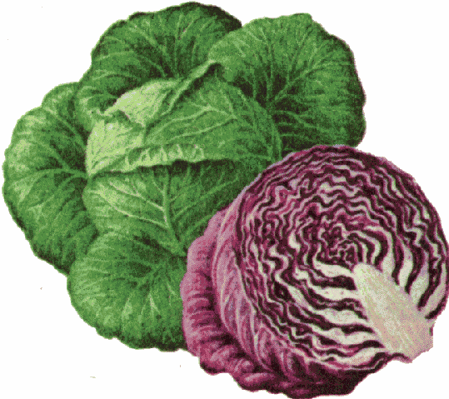
Edible Acid-Base Indicators
COLOR CHANGES AS A FUNCTION OF pH
INDICATOR pH 2 3 4 5 6 7 8 9 10 11 12
RED APPLE SKIN
BEETS
BLUEBERRIES
RED CABBAGE
CHERRIES
GRAPE JUICE
RED ONION
YELLOW ONION
PEACH SKIN
PEAR SKIN
PLUM SKIN
RADISH SKIN
RHUBARB SKIN
TOMATO
TURNIP SKIN
*
*YELLOW at pH 12 and above
Notes:
Source: Volume 62, Number 4, April 1985 pg 285 (Not sure of magazine title)

Slide 64
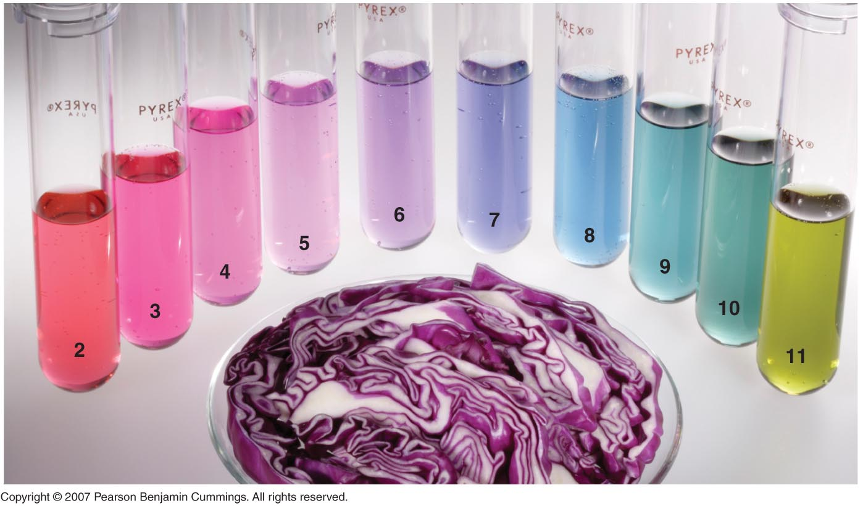
Red Cabbage Indicator
Copyright © 2007 Pearson Benjamin Cummings. All rights reserved.

Slide 65
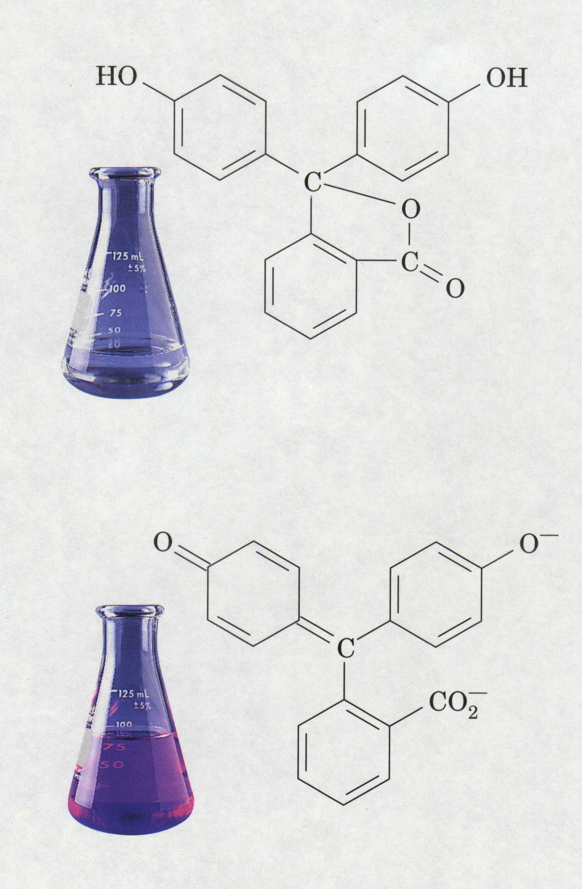
Phenolphthalein Indicator
H⁺
Colorless = Acidic pH
Pink = Basic pH

Slide 66
⁻O
OH
O
HO
C
C
OH
C
O⁻
C
O⁻
O
O
(Colorless acid form, HIn)
(Pink base form, In⁻)

Slide 67
oxidizing agents used in titrations

Slide 68
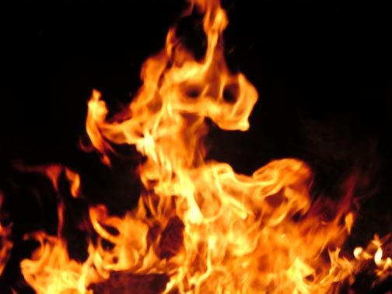
Oxidation-Reduction Reactions (Redox Reactions)

Slide 69
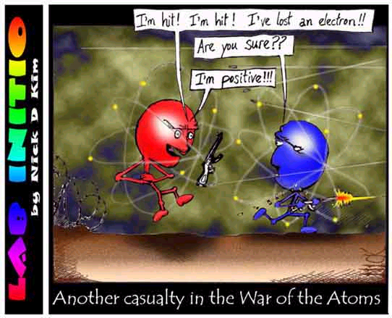
The chemical changes that occur when electrons are transferred between reactants are called oxidation – reduction reactions

Slide 70
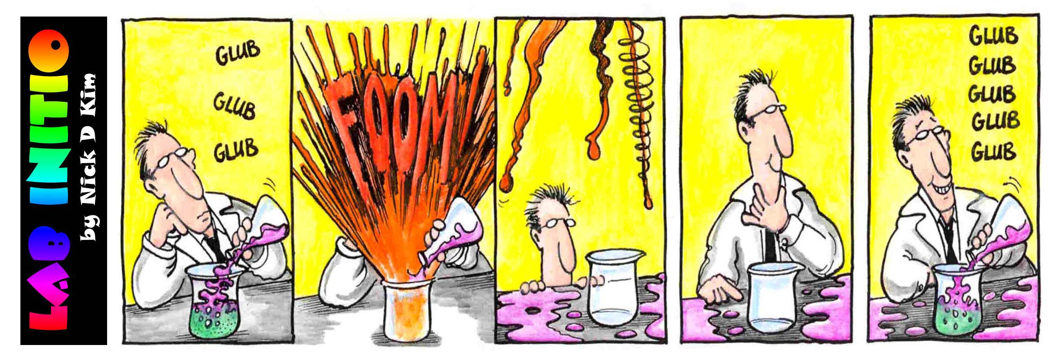
oxidation reactions
- -principal source of energy on earth
- -combustion of gasoline
- -burning of wood
-burning food in your body

Slide 71
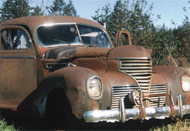
Oxidation reactions are always accompanied by a reduction reaction
Oxidation
- originally meant combining with oxygen
- iron rusting (iron + oxygen)
Reduction
- originally meant the loss of oxygen from a compound
removing iron from iron ore ( iron II oxide)

Slide 72
Electron Transfer in Redox Reactions
Today
OXIDATION means:
- a LOSS of ELECTRONS
REDUCTION means:
- a GAIN of ELECTRONS
Memory Device :
LEO the lion says GER
(Lose Electrons Oxidation, Gain Electrons Reduction)
OIL RIG (Oxidation Is Loss, Reduction Is Gain)

Slide 73
Oxidation is…
the loss of electrons
an increase in oxidation number
Na → Na⁺ + e⁻
notice the electrons are on the right
Reduction is…
the gain of electrons
a decrease in oxidation number
Cl₂ + 2e⁻ → 2Cl⁻
notice electrons are on the left

Slide 74
Assigning Oxidation Numbers
Oxidation States
Oxidation states are numbers assigned to atoms that reflect the net charge an atom would have if the electrons in the chemical bonds involving that atom were assigned to the more electronegative atoms.
Oxidation states can be thought of as “imaginary” charges. They are assigned according to the following set of rules:

Slide 75
#1
The Oxidation number of a simple ion is equal to its ionic charge
+1 +2 -3
Na ⁺ Cu ²⁺ N³⁻

Slide 76
#2
The Oxidation number of hydrogen is always +1, except in metal hydrides like NaH where it is –1
+1 -1
HCl NaH

Slide 77
#3
The Oxidation number of oxygen is always –2 except in peroxides like X₂O₂ where it is –1
-2 -1
H₂O H₂O₂

Slide 78
#4
The Oxidation number of an uncombined element is always zero
0 0 0
Na Cu N₂

Slide 79
#5
For any neutral(zero charge) compound, the sum of the Oxidation numbers is always zero
+4-2
CO₂

Slide 80
#6
For a polyatomic ion, the sum of the oxidation number equals the charge of the polyatomic ion
+7 -2
MnO₄¹⁻

Slide 81
Examples - assigning oxidation numbers
Assign oxidation states to all elements:
https://www.youtube.com/watch?v=lQ6FBA1HM3s

Slide 82
Oxidation # Changes
an increase in oxidation number of an atom signifies oxidation
+2 to +4
a decrease in oxidation number of an atom signifies reduction
0 to -1

Slide 83
Common Oxidizing agent and their properties
I- Potassium permanganate
II- Potassium dichromate
III- Cerric sulphate
IV-Iodine (Iodimetry & Iodometry)
V- Potassium iodate.: Andrew’s reaction, lang’s modification
VI- Potassium bromate

Slide 84
I- Potassium permanganate (KMnO₄)
It is a very strong oxidizing agent, a self indicator
its solution deteriorate rapidly on standing so it is not primary standard.
KMnO₄ + 2H₂O ↔ 4 MnO₂+ 4OH⁻ + 3O₂
H₂SO₄ is used for acidification in reaction involving KMnO₄ but not HCl. As some KMnO₄ is consumed in the oxidation of HCl
2KMnO₄ + 16HCl ↔ 2 MnCl₂+ 2KCl + 5Cl₂ + 8H₂O

Slide 85
In slightly alkaline medium
MnO₄⁻ (permangaaate) is reduced to MnO₂ (brown)
MnO₄⁻ + 4H⁺ + 3e ↔ MnO₂+ 2H₂O
In strong alkaline medium
MnO₄⁻ (permanganate) is reduced to MnO₄²⁻ (green) (manganate)
MnO₄⁻ + e ↔ MnO₄²⁻
In acid medium
MnO⁴⁻ is reduced to Mn²⁺ and can oxidize the following ion( faint pink to colourless)
MnO⁴⁻ + 8H⁺ + 5e ↔ Mn²⁺ + 4H2O

Slide 86
II- Potassium dichromate ( K₂Cr₂O₇)
It acts in acid only, therefore it has only one equivalent weight. (E₀ = 1.33)
Cr₂O₇²⁻ + 14H⁺ + 6e → 2Cr³⁺ + 7H₂O
It is not a powerful oxidizing agent as permenganate
It is a primary standard, highly pure and stable.
It can be used in presence of H₂SO₄ and HCl as it cannot oxidize chloride.

Slide 87
III-Cerric sulphate Ce (SO₄)₂
Ce⁴⁺ + e → Ce³⁺
(yellowish orange) (colorless)
Cerric used only in acidic Medium to prevent precipitation of CeO₂.XH₂O
Although , it can be used as self indicator ,it’s better to use internal redox indicator such as ferroin
It’s solution is very stable

Slide 88
IV-Iodine
I₂ + 2e ↔ 2I⁻
Brown colorless
Redox reaction involving iodine:
Standard oxidation potential = 0.535 v
Redox system that have higher oxidation potential than I⁻ / I₂
Redox system that have lower oxidation potential than I₂/I⁻
Other system which have oxidation potential near I₂/I⁻

Slide 89
Redox system that have higher oxidation potential than I⁻ / I₂
I⁻ can be oxidized by systems of higher oxidation potential as MnO₄⁻
as Cr₂O₇²⁻
2 MnO₄⁻ +10 I⁻+16 H⁺ → 5 I₂ + 2Mn²⁺+8H₂O
Cr₂O₇²⁻+6I⁻ +14H⁺→ 2Cr³⁺+ 3I₂ +7H₂O
Iodometric titration: Indirect Titration of Iodide Add KI to oxidizing agents, equivalent I₂ is libarated and titrated with Na₂S₂O₃ , Used for determination of oxidizing agents

Slide 90
B. Redox system that have lower oxidation potential than I₂/I⁻
I₂ can oxidize systems of lower oxidation potential
As Sn²⁺
Sn²⁺ + I₂ → Sn⁴⁺ +2I⁻
As S₂O₃²⁻
2S₂O₃²⁻ + I₂ → S₄O₆²⁻ +2I⁻
As S²⁻
S²⁻ +I₂ → S↓ +2I⁻
Iodimetric method: Direct titration with I₂ To determine reducing agents

Slide 91
C. Redox system that have oxidation potential near I₂/I⁻
Systems having oxidation potentials near to that of iodine/iodide e.g AsO₄³⁻/AsO₃³⁻, Fe³⁺/Fe²⁺
Change in oxidation potential, addition of complexing agents or addition of precipitating agents.
Example 1: Determination of arsenite by iodine
The potential of: AsO₄³⁻/AsO₃³⁻= + 0.57 and I₂/2I⁻ = + 0.54
The pH of the solution should be adjusted by adding NaHCO₃
I₂ + AsO₃³⁻ + H₂O ↔ 2I⁻ + AsO₄³⁻ + 2H⁺
E AsO₄³⁻/ AsO₃³⁻ =E_{o}+

Slide 92
Example 2: Determination of ferrous by iodine
E₀ of Fe³⁺/Fe²⁺= 0.77V E₀ of I₂/ 2I⁻ = 0.54V
E Fe²⁺ / Fe³⁺ = 0.77 +
When phosphate,or F⁻ is added to the Fe³⁺/Fe²⁺ system it form [FeF₆]³⁻ or [Fe(PO₄)₆]³⁻
Thus:
removing the Fe³⁺ ions from the share of the reaction,
minimizing its concentration,
lowering the oxidation potential of Fe³⁺/ Fe²⁺ below that of I₂/2I⁻ system.
On other hand, to oxidize iodide by ferric use carbon tetrachloride to decrease the concentration of iodine

Slide 93
Theory of Internal, External and self indicators for redox titration

Slide 94
Requirement of a redox indicator
The two colors of the indicator (redused form and oxidised form) should be sufficiently different so that the color change would be sharp.
The color change should be intense so that small amount of titrant gives the color change.
The transition potential of the indicator should be in between the E_{o} values of the 2 systems used in the titration.
i.e. Lower than the titrant but higher than the sample.

Slide 95
Detection of the end point in Redox titrations
We detect the end point during redox titration by using indicators.
Types of redox indicators
1- Self indicator (no indicator e.g. KMnO₄, I₂)
2- External indicator (Ferricyanide)
3- Internal indicator (Ferroin, Diphenylamine)

Slide 96
1- Self indicator (No indicator method):
If the color of the titrating agent undergoes a sharp enough change in color at the equivalence point. E.g. KMnO₄, I₂
Example 1: KMnO₄, During titration the purple color of permenganate disappears due to formation of colorless Mn²⁺
End point: permenant apperance of pale pink color.
Example 2: Iodine: Similarly, disapperance of the color of iodine due to its reduction to iodide, at the end pt. There should be the brown color of exx iodine.
But the color of I₂ is not deep, so, we add starch which forms an intense blue color (adsorption complx) with exx free I₂.
If starch could not be used, CHCl₃ can be used as I₂ has violet color in CHCl₃

Slide 97
Detection of the end point in iodine titrations:
Iodine is a self indicator:
The use of starch:
Starch is giving a deep blue adsorption complex with traces I_{2.} In indirect iodometric titration, an irreversible blue adsorption complex is formed which is not changed so Starch must be added just before the end point.
Starch can not be used in:
- Strong acid medium: due to hydrolysis of starch
- Alcoholic solu: because alcohol hinders the adsorption of I₂ on starch
In presence of alcohol or conc acids, organic solvents are recommended as indicators. I₂ is soluble in CHCl₃ or CCl₄ 90 times more than in H₂O

Slide 98
2- External indicators: Spot test method
Example for the determination of Fe²⁺ with K₂Cr₂O₇ (Ferricyanide)
During titration: Fe²⁺ forms a blue color with ferricyanide.
At the equivalence point, drops of ferrous sample are removed and brought in contact with freshly prepared solution of potassium ferricyanide on a spot plate. When all Fe²⁺ is oxidized by K₂Cr₂O₇, no more Fe²⁺ ions are available and the sample will not give a blue color with ferricyanide.

Slide 99
3- Internal indicators:
Redox indicator are organic compounds which have different colors in oxidized and reduced form.

Slide 100
Examples of redox indicators:
1. Diphenylamine: Is a redox indicator, (E₀ = 0.76, n = 2)
Diphenylamine changes its color from the reduced form predominates (colorless) to the oxidized form predomintes (blue-violet).
Notes: Diphenylamine (E₀ 0.76) is unsuitable indicator for the determination of ferrous (E₀ Fe³/Fe²⁺ 0.77) with dichromate (E₀ Cr₂O₇²⁻/Cr³⁺ 1.36). This is because E₀ of Fe³/Fe²⁺ and E₀ of diphenylamine are very close. So we have to lower the oxidation potential of Fe³⁺/Fe²⁺ by adding PO₄³⁻.

Slide 101
2. Ferroin: (E₀ = +1.06 V) It is ferrous (center atom) surrounded by 3 molecules of 1,10 ortho phenanthroline
It is intensely red and is converted by oxidation into the pale blue ferric complex (Ferrin).
As E₀ = +1.06 V, It is an excellent indicator for titration involving Ce⁴⁺ E₀ = +1.44 V. Only disadvantages that it is expensive.

Slide 102
Thank you!

